Slide 1



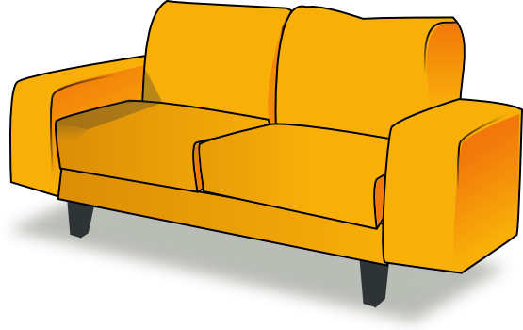
Where you should NOT use your laptop

Slide 2
Wrong

Slide 3
Wrong

Slide 4
Correct ! Well Done !
Using your laptop in the bath is a bad idea , water and electricity are a bad combination

